Slide 1

Decentralized IoT Solution for Smart Agriculture Using LoRaWAN and Edge Computing
GUIDE NAME:
Prof. Jeyapandian
Asst. Professor-II
STUDENT NAME:
Kishore B
225003069

Slide 2
Table Of CONTENTS
Base-paper Title and Info
Abstract
Problem Statement
Literature Survey
Workplan
Methodology
Conclusion

Slide 3
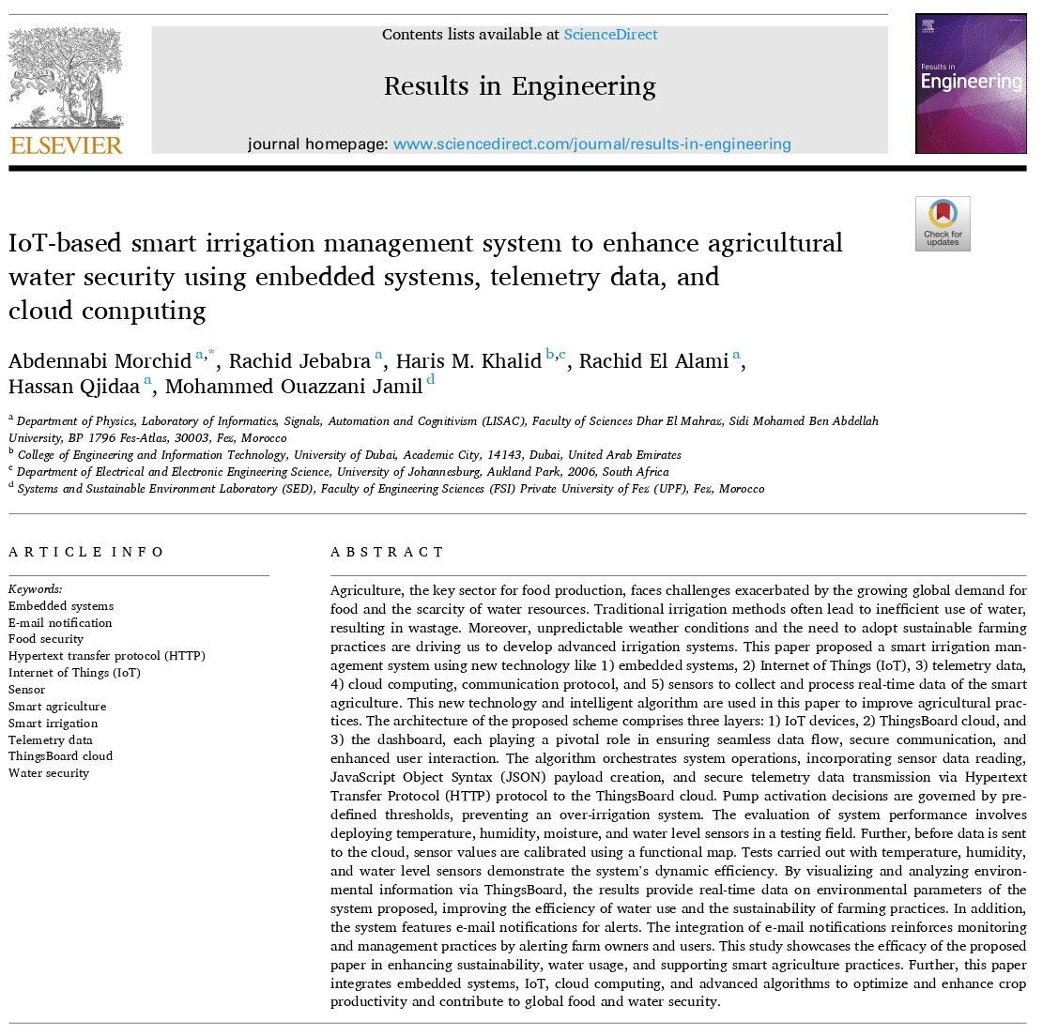
Base Paper Title:
IoT-based smart irrigation management system to enhance agricultural water security using embedded systems, telemetry data, and cloud computing
Authors: Abdennabi Morchid Hassan Qjidaa, Rachid Jebabra, Haris M. Khalid, Mohammed Ouazzani Jamil, Rachid El Alami
Source: ScienceDirect

Slide 4
Abstract
Previous smart irrigation systems face limitations such as dependency on third party cloud services, limited connectivity range, inefficient water usage, and lack of data privacy. These challenges often hinder the effectiveness and scalability of traditional solutions. To address these issues, this project proposes a decentralized smart irrigation system tailored for agricultural fields. Using a master-slave architecture, the Raspberry Pi acts as the master node while multiple ESP32 nodes serve as slave nodes, each equipped with a soil moisture sensor and a sprinkler. With LoRa communication for long-range, low power connectivity, the slave nodes monitor soil moisture levels every five minutes and send the data to the master node. The master node hosts a private, decentralized web server for real-time monitoring and decision-making, eliminating the need for third-party cloud services. When the soil moisture falls below a certain threshold, the corresponding slave node activates its sprinkler, ensuring precise water usage and shutting it off when the moisture level is restored. This approach improves data privacy, reduces reliance on external cloud platforms, and enhances irrigation efficiency, contributing to sustainable and autonomous farming practices.

Slide 5
Problem Statement
Dependency on External Platforms and Data Privacy Concerns
Traditional smart irrigation systems often rely on third-party cloud services for data storage, processing, and decision-making. While this approach enables remote monitoring and control, it raises significant concerns regarding data privacy and security. Previous research on IoT-based irrigation models highlights that storing sensitive agricultural data on external servers exposes it to potential breaches, unauthorized access, and data misuse. Additionally, the reliance on cloud-based platforms increases operational costs and creates dependency on service providers, which can lead to service disruptions if the platform experiences downtime or policy changes. These limitations underscore the need for decentralized solutions that allow farmers to retain control over their data while ensuring secure and efficient irrigation management.

Slide 6
Problem Statement
Connectivity Limitations in Large Agricultural Fields
Another critical challenge observed in existing IoT-based smart irrigation models is their limited connectivity range. Many traditional systems use Wi-Fi or short-range communication technologies such as Zigbee and Bluetooth, which are unsuitable for large-scale agricultural fields, especially in rural areas with poor network infrastructure. Studies have shown that such limitations result in incomplete data collection from distant sensors, reducing the accuracy of soil moisture monitoring and irrigation scheduling. Moreover, dependency on internet-based services makes these systems vulnerable to network outages, affecting real-time decision-making and autonomous irrigation. To overcome these challenges, there is a growing need for low-power, long-range communication protocols like LoRaWAN, which can enhance coverage while reducing power consumption for sustainable and efficient irrigation solutions.

Slide 7
Literature Survey
S.No | Title | Methodology | Merit | Demerit
1. | AUTOMATIC IRRIGATION SYSTEM - Department of Information & Communication Technology Comilla University – [2024] | Arduino Uno controls soil moisture sensors to automate irrigation. A relay module operates a water pump, ensuring plants get water only when needed. | Water-saving Efficient Water Control | No Remote Control or Monitoring
2. | Automatic Irrigation System using Soil Moisture Sensor – Link – [2023] | Arduino Uno reads soil moisture levels and controls a relay-operated water pump for automated irrigation, reducing water waste and manual effort. | Simple to implement | No Remote Control or Monitoring

Slide 8
Literature Survey
S.No | Title | Methodology | Merit | Demerit
3. | Smart irrigation system based on IoT and machine learning – Science Direct – [2022] | IoT sensors collect soil, temperature, and rain data. Machine learning models (KNN, SVM, Neural Networks) predict irrigation needs, optimizing water efficiency and automation via Node-RED and MongoDB. | Uses ML model Uses DB | No Remote Control or Monitoring Non interactable
4. | IoT based Smart Irrigation System using Soil Moisture Sensor and ESP8266 NodeMCU – circuitdigest.com link – [2021] | ESP8266 NodeMCU reads moisture, temperature, and humidity. Data is sent to ThingSpeak, and the pump operates automatically based on moisture levels. | Remote Monitoring More features sensed User Friendly | No privacy [ThingSpeak used] Only useful for small lands

Slide 9
Literature Survey
S.No | Title | Methodology | Merit | Demerit
5. | IoT based Smart Irrigation System – [Electrical Engineering Department, Egyptian academy for engineering and advanced technology] – [2022] | IoT sensors monitor soil, temperature, and rain. ESP32 microcontrollers process data for automated irrigation, controlled via mobile/web apps using MQTT protocol. | Remote monitoring Cheaper MC Used | No privacy [Third party Brokers used]
6. | IoT and Cloud Based Sustainable Smart Irrigation System – E3S Web of Conferences 472 – [2023] | IoT sensors monitor soil moisture and weather. NodeMCU processes data and controls irrigation via cloud-based automation, optimizing water use and enabling remote access. | Remote Control Cost-saving | High setup cost Heavy MC used

Slide 10
Workplan
0th Review
Prepare Ideation
1st Review
Connection between Raspberry Pi and Esp32
2nd Review
Modify Connection
Create PPTs
Draft Workplans
Implement detection and pump control
Complete IoT Physical
Document Submission
Configure Rasp as Web Server
Add Features

Slide 11
Methodology
The system consists of a Raspberry Pi as the master node and multiple ESP32-based slave nodes, each equipped with a soil moisture sensor and a sprinkler. These nodes are strategically placed across the field and communicate with the Raspberry Pi using LoRa for long-range wireless data transmission.
Every 5 minutes, the ESP32 nodes measure the soil moisture levels and send the data to the Raspberry Pi, which updates it on a webpage for the landowner to monitor in real time. When the moisture level drops below a set threshold, the sprinkler automatically activates and remains on until the soil reaches the required moisture level, ensuring optimized irrigation.
This method enables automated water management, reducing manual effort and water wastage while providing a smart, decentralized, and efficient irrigation system.

Slide 12
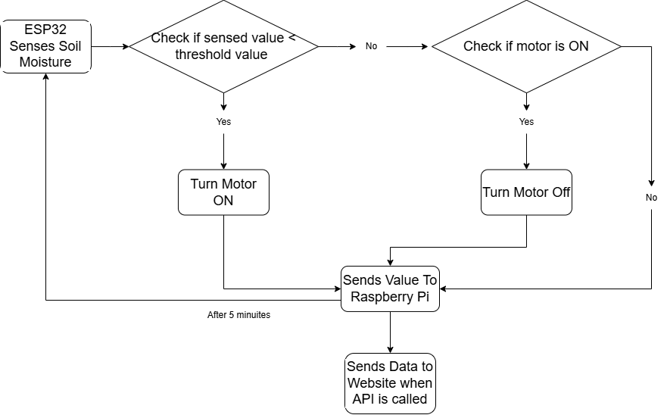
Methodology
Through LoRaWan

Slide 13
Conclusion
The system proposed with LoRaWAN and decentralized web hosting provides long-range coverage for sensor connections and privacy for users when transmitting data from the microcontroller to the website. This ideation will be enhanced in the future and submitted in further reviews.

Slide 14


